Slide 1

Resume Building
For
Data Scientists

Slide 2
Plan of Attack
Strategy
Building a Resume
Section wise discussion
General points

Slide 3
Strategy
1 page resume
Design of the resume
Tell a story
Customize
Get 1 point to click
Also talk about transferable skills

Slide 4
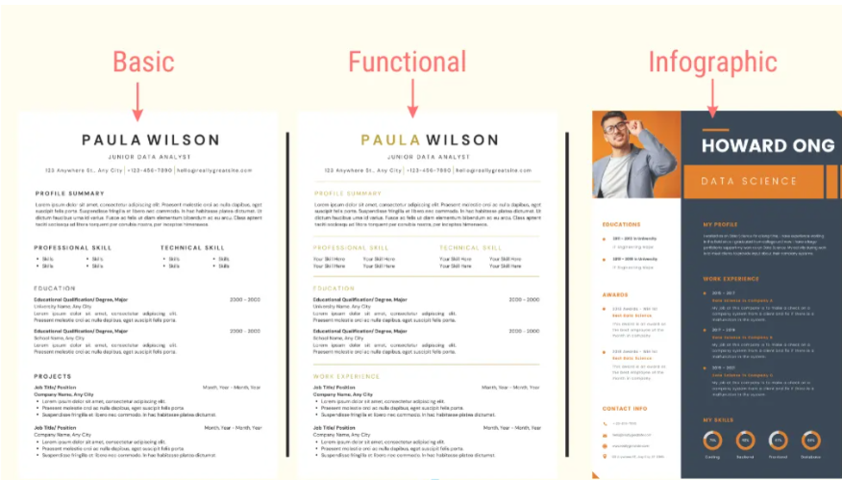
Types of Resume

Slide 5
Where can I build my resume?
Google Docs
Canva
Other Websites like zety

Slide 6
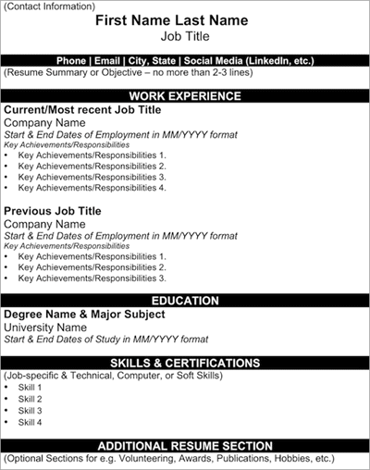
Resume Formatting
Use an elegant text font
Good examples: Calibri, Times New Roman, Arial, Verdana, Cambria, Tahoma, Georgia
Bad examples: Comic Sans MS, MS Gothic, Ink Free, Agency FB, OCR A Extended
Use font size: 11-12pt for the text, 14-16pt for headings
Make section headings and the header bold
Avoid using too many text styles such as bold, italic, bold-italic and underlined
Use 1-1.15 line spacing
Avoid visual effects, decorations, or unnecessary icons
Use bullet points to make your resume look clean, well-organized, and easy to follow
Don't use redundant headings
Relevant Work Experience - Just write Experience
Skills and Tools - just write Skills
Additional Information - write Extras

Slide 7
Resume Structuring
Freshers
Experienced
Header
Header
Resume Summary
Resume Summary
Education
Experience
Skills
Skills
Experience if you have any
Education
Extra
Extra

Slide 8
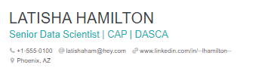
Header
Name -> Subheading -> Phone -> Professional email -> linkedin -> other
No need for address
Add Linkedin if it offers something
Optional Photo

Slide 9
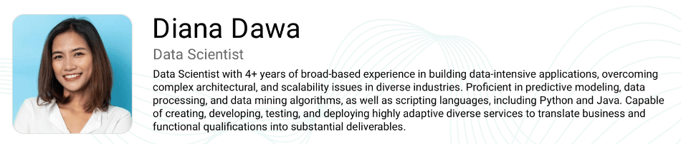
2. Summary
Should not be a copy paste
Personalize
Example on next slide

Slide 10
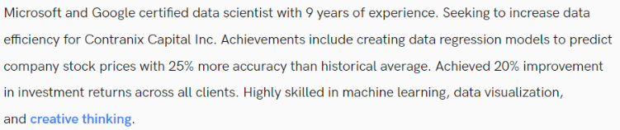
Example(Experienced)

Slide 11
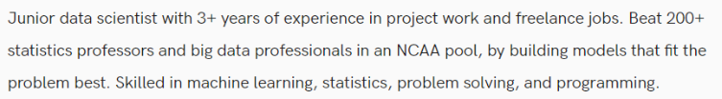
Example(Fresher)

Slide 12
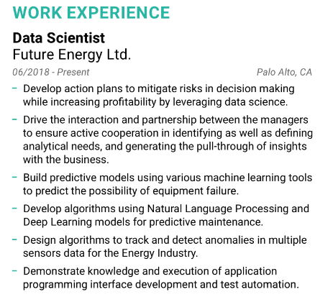
3. Experience
Explain responsibility and impact
Reverse Chronological order
Freshers -> shadow experience

Slide 13
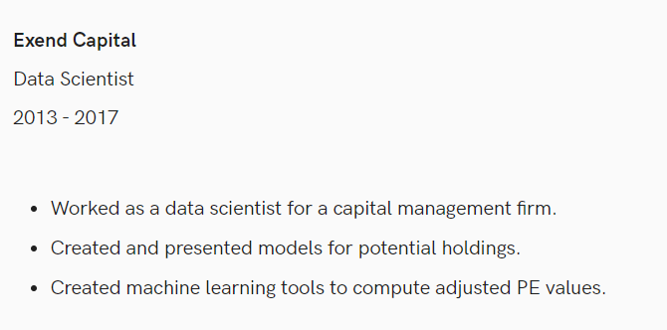
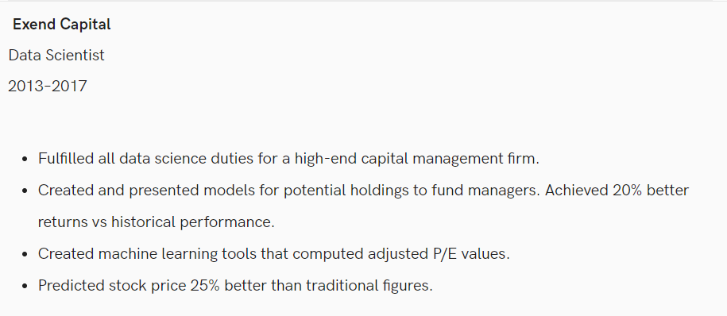
Example(Experienced)

Slide 14
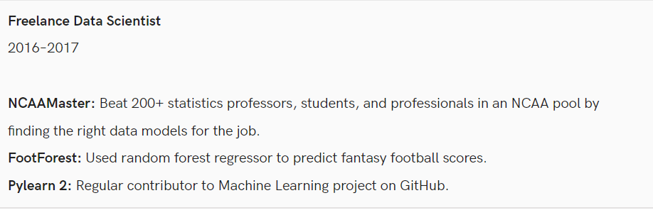
Example (Freshers)
Kaggle Competition
Freelance Work
Open Source Contribution

Slide 15
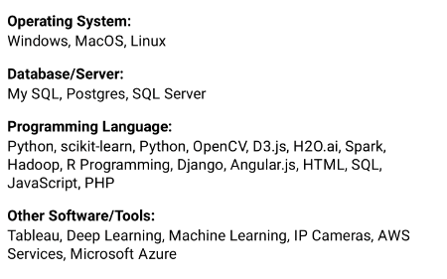
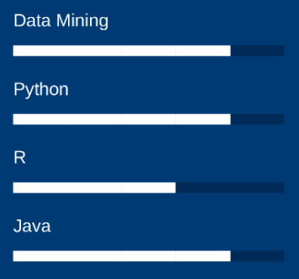
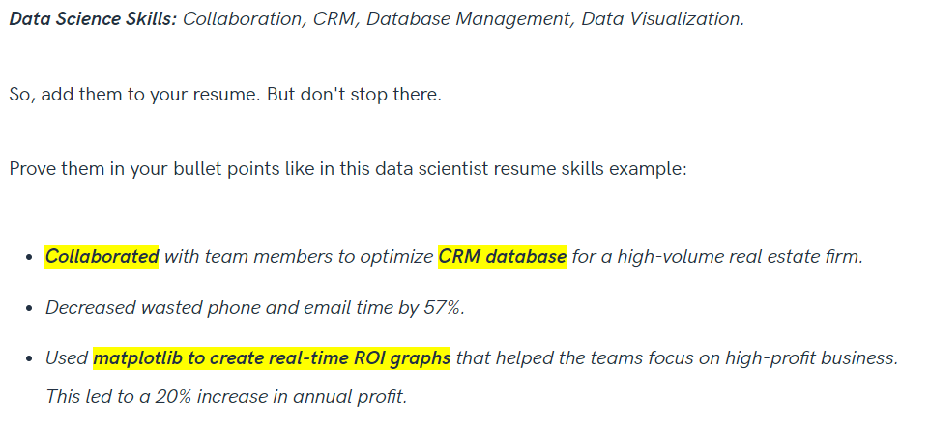
Skills
Categorize
Don’t self rate
Use skills in explaining projects/experience

Slide 16
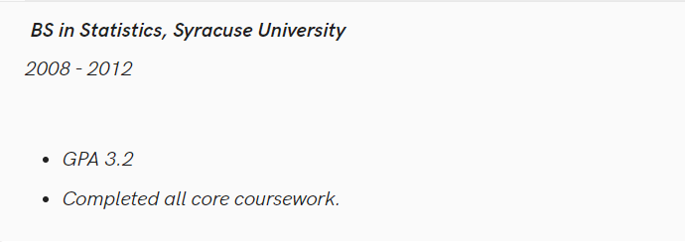
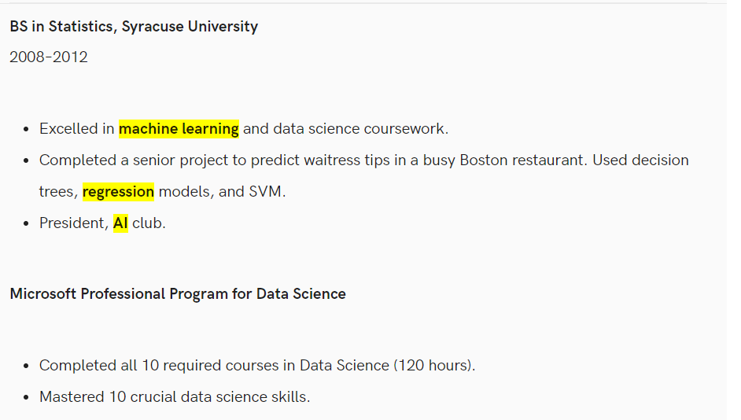
Education
Reverse Chronological
Explain what you learnt
Add relevant coursework/
certifications

Slide 17
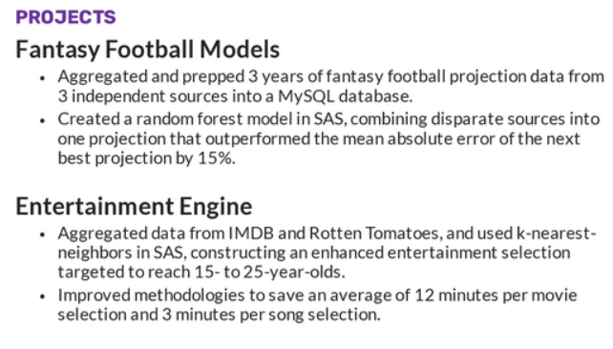
Projects
Explain Projects with
metrics
Write relevant project first
Recruiters love words like
Unstructured data,
problem solving, team work

Slide 18
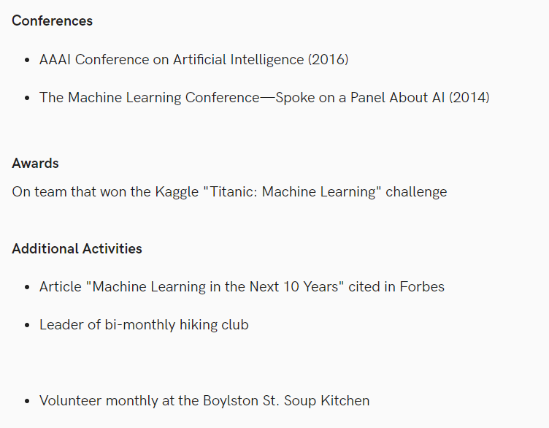
Extras
Achievements
Publications
Extra-curriculars
About Yourself

Slide 19
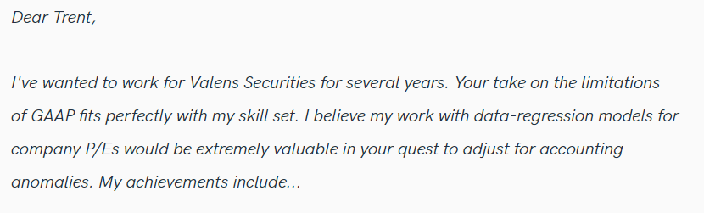
Cover Letter
Never miss this
Personalize
Use your own words
Again be to the point and
Use metrics

Slide 20
General Points
Study a lot of relevant examples
Get multiple feedback -> Resume worded
Iterate
No Typos
Hide things that you are not confident of
Save and share in pdf

